Slide 1
Teacher Resource Guide
This guide provides insight into the decisions we made, and the benefits we believe students procure from these pedagogical and instructional components. As with any curriculum activity, it is only effective if it is fitting the needs of your classroom and your students. Therefore, we include several instructional strategies to make the curriculum meaningful in your classroom.
How to use the guide
This resource is for the Comparing National Responses: Italy, U.S., and Switzerland activity.
Tips in red are discussion prompts to help facilitate discourse around topics.
Green text points out the connection to socioscientific issues (SSI) and the skills being developed.
Instructional strategies are in blue text. These are possible ways to implement the activities.
Overview
In this activity, students interpret COVID-19 data from the United States, Italy, and Switzerland, analyze the data in relation to government policies, and draw conclusions about policy implementation and COVID-19 cases. This exercise pushes students to think critically about the government role in responding to the pandemic and the resulting consequences of government action or inaction. This activity prepares students to develop their own policy proposals by considering implications for public safety, economic repercussions, and political forces at work when implementing COVID-19 precautions and policies in the general public.

Slide 2
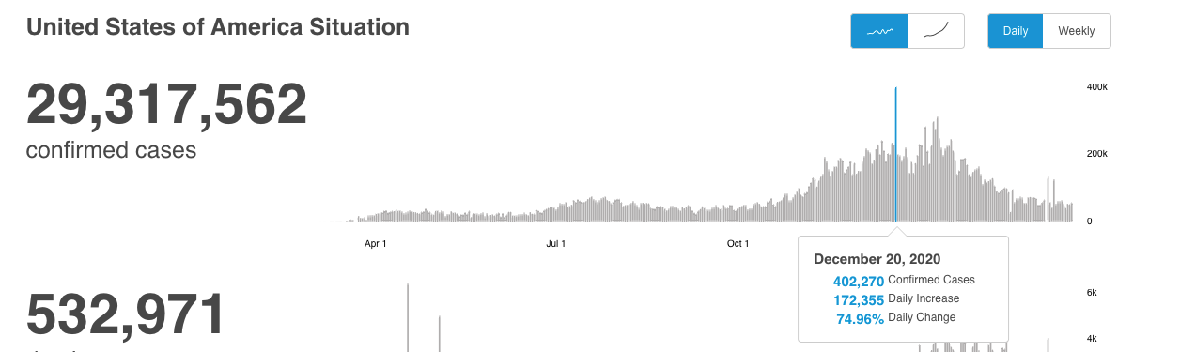
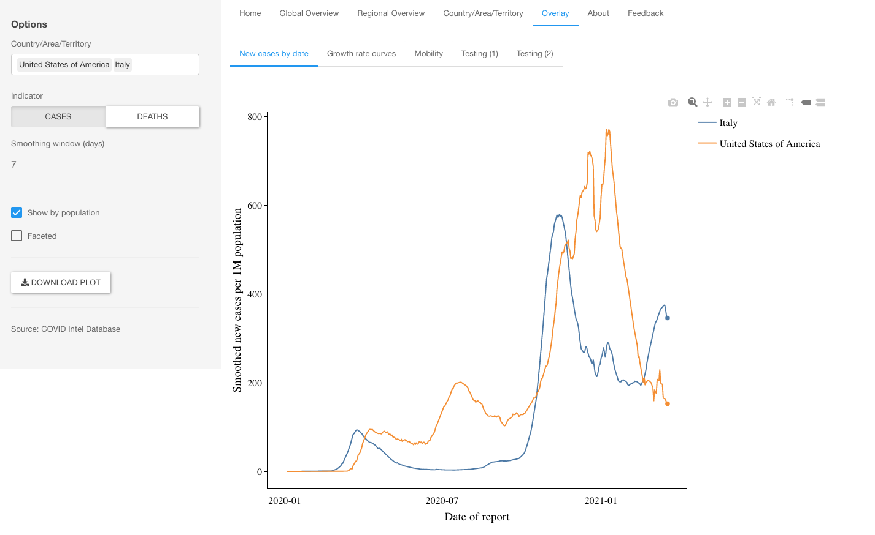
Teacher Resource: Comparing National Responses to COVID-19: Italy, U.S., & Switzerland
This activity can easily be completed within one class period. We recommend about 25 minutes of independent work followed by class discussions. This activity serves as a scaffold to the final project. Share with students that in their summative assignment they will be asked to develop a policy proposal and examine the positive and negative consequences of their policy. Investigating the government responses and COVID cases from these three countries will provide a baseline knowledge for all students to work from.
We recommend using the digital graphs because they offer much better access to the data, present it in a way that is easier to identify trends, and updates to reflect the most recent data. Answers included in this guide are from March 19, 2021.
Accessing and using the graphs:
Graphs are all found on the CDC website.
United States: https://covid19.who.int/region/amro/country/us
Italy: https://covid19.who.int/region/euro/country/it
Per Capita Data: https://worldhealthorg.shinyapps.io/covid/
Switzerland: https://covid19.who.int/region/euro/country/ch
Scroll down to the bottom where the bar graphs are located. Using your mouse, hover over individual bars for more information.
The third graph has more steps to accessing the information. Make sure you follow all three steps to get the picture on the left.

Slide 3
Teacher Resource: Comparing National Responses to COVID-19: Italy, U.S., & Switzerland
Interpret
What was the highest number of confirmed daily cases in Italy?
40,902 confirmed cases
When did Italy see its highest number of confirmed cases?
November 14, 2020
What was the highest number of confirmed daily cases in the USA?
667,188 Confirmed cases
When did the USA see its highest number of confirmed cases?
December 21, 2020
Analyze
What pattern can you see in the number of deaths in each country?
The deaths were highest when the number of cases was the highest, and the number of cases was the highest surrounding holidays and high travel times.
Which country has been most successful in reducing COVID-19 cases over time? How did you come to that conclusion?
The united states has been able to reduce the number of cases drastically over time. They still had an increase around the holidays, but there is a big difference between the highest number of cases the U.S. had and where we are now. Italy has had less of a drastic change in their case numbers, but they got their cases under control by March-the United States struggled with case numbers for a long time.
Go to the link https://worldhealthorg.shinyapps.io/covid/
Click Overlay
On the left, in the country/area/territory box, select the United States and Italy
Click Show by Population
How many cases did Italy have per 1 million people on November 14, 2020?
580.08 per 1 million people
How many cases did the United States have per 1 million people on January 10, 2021?
770.41 per 1 million people
After comparing the trends for the United States and Italy’s COVID-19 cases, what is surprising to you?
I first thought the United States only had so many more cases because we have so many people than Italy, but now I see that we still had more cases for our population. I’m surprised because we are supposed to be advanced medically, but we didn’t do a great job of keeping our cases down.
These answers will vary.
Consider the following points for class discussions:
If you get COVID-19 in Italy, you are much more likely to die from it. Why do you think that is? (older population, higher population of smokers)
Spikes in death rate when the hospitals are over run by patients
Any potential for the data to be inaccurate (not reporting accurately, many people not getting tested that might have COVID, people not liking how the test is administered, so they avoid it).
This answer will vary depending on students’ perception of how the U.S. handled COVID. Talk to students about their opinions on how their local government responded to the pandemic.

Slide 4
Teacher Resource: Comparing National Responses to COVID-19: Italy, U.S., & Switzerland
Read the editorial How the US and Italy Traded Places on Coronavirus and answer the following questions.
https://www.politico.eu/article/how-the-us-and-italy-traded-places-on-coronavirus/
Describe at least 5 policies that Italy’s government put into action that might explain why their Covid-19 cases have decreased so much?
(1) Banned jogging (2) one at a time entry into grocery stores (3) lockdown (4) required masks
(5) Closed restaurants and stores
Describe at least 3 reasons why the number of United States COVID-19 cases remain so high, according to the article.
(1) Compared to other countries, U.S. government was slow to enact any policies
(2) CDC had early failure in testing
(3) No universal healthcare, so many people struggled to get the test and treatment they needed
(4) Lifted lockdowns early
In your opinion, what are the most important government policies needed to reduce the number of COVID-19 cases and why?
Answers will vary.
Read the editorial Switzerland Is Choosing Austerity Over Life and look at the graph of Switzerland’s COVID-19 Situation.
Article: https://foreignpolicy.com/2020/11/10/coronavirus-switzerland-is-choosing-austerity-over-life/
Switzerland’s COVID Situation
In 3-5 sentences describe the trends you see in Switzerland’s COVID-19 cases and the policies the government implemented. How do these compare to the U.S. and Italy?
Answers will vary.
This could also be done as a partner/group activity and learners could be asked to make a T- Chart comparing the different responses. They could then work together to form an opinion about what is important in government policies when reducing COVID cases. As a class, make a list of what students found to be the most important and refer to that list throughout the unit.
It is important for students to have agency within SSI learning experiences. Activities that allow student to interact with and analyze data should be complemented by opportunities for them to examine their own opinions, perspectives, and values.
Consider the following for class discussion:
The consequences of governments not taking action when there is a crisis. How does that affect the people?
The importance of commerce to country’s economy led them to reopen even though it was dangerous. How do students feel about that?

